Slide 1

Go, change the world
RV College of
Engineering
Experiential Learning
Phase 1: Presentation
CYCLE | Physics Cycle
BRANCH | Computer Science and Engineering

Slide 2
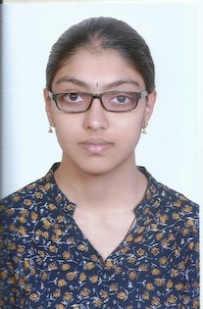

TEAM INTRODUCTION
Roll No. | Admission No. | Name | Email Id
24 | RVCE20BCS023 | Sravan Karthick T | sravankt.cs20@rvce.edu.in
25 | RVCE20BCS024 | Neha N | nehan.cs20@rvce.edu.in
26 | RVCE20BCS025 | Gaurav M Shastry | gauravmshastry.cs20@rvce.edu.in
58 | RVCE20BCS057 | Shubhaprada K P | shubhapradakp.cs20@rvce.edu.in

Slide 3
INTRODUCTION
What is IoT?
The term “IoT” stands for the internet of things, can be defined as the interconnection between the individually identifiable embedded computing apparatus in the accessible internet infrastructure. The ‘IoT’ connects various devices and transportations with an help of internet as well as electronic sensors.
IoT in agriculture
IoT in agriculture uses robots, drones, remote sensors and computer imaging combined with continuously progressing machine learning and analytical tools for monitoring crops, surveying and mapping the fields and provide data to farmers for rational farm management plans to save both time and money.

Slide 4
Literature Review-1
AUTHOR: G.Sushanth and S.Sujatha
PAPER : IOT Based Smart Agriculture System
SUMMARY | REMARK | PUBLICATION DETAILS
Paper proposes a Smart agriculture System that uses technologies such as Arduino, IOT and Wireless Sensor Network Includes development of a system which can monitor temperature, humidity, moisture through sensors using Arduino board in case of any discrepancy send a SMS notification as well as a notification on the application developed for the same to the farmer's smartphone using Wi-Fi/3G/4G. | This system can recommend farmer whether or not, is there a need for irrigation. Continuous internet connectivity is required. This can be overcome by extending the system to send suggestion via SMS to the farmer directly on his mobile using GSM module instead of mobile app. | Published in: 2018 International Conference on Wireless Communications, Signal Processing and Networking (WiSPNET) Date of Conference: 22-24 March 2018 Date Added to IEEE Xplore: 19 November 2018 ISBN Information: INSPEC Accession Number: 18269070 DOI: 10.1109/WiSPNET.2018.8538702 Publisher: IEEE Conference Location: Chennai, India

Slide 5
Literature Review-2
AUTHOR: G. Shanmugasundaram ,K. K. Prasanth ,G. Magesh ,B. Sriram
PAPER :"Automated Irrigation System”
SUMMARY | REMARK | PUBLICATION DETAILS
In order to overcome issues such as water scarcity, lack of human resource etc an optimized Automatic Irrigation System is developed collects Datasets from the field using sensors and analytics is done for deciding the threshold value. Live values from the sensors is mapped with the threshold value, if both the values matches water is either irrigated to or drained from the field | Prototype has been developed to make efficient use of water based on field conditions Datasets have been collected and analyzed it to set threshold values. | Published in: 2019 IEEE International Conference on System, Computation, Automation and Networking (ICSCAN) Date of Conference: 29-30 March 2019 Date Added to IEEE Xplore: 24 October 2019 ISBN Information: INSPEC Accession Number: 19082745 DOI: 10.1109/ICSCAN.2019.8878737 Publisher: IEEE Conference Location: Pondicherry, India

Slide 6
Literature Review-3
AUTHOR: Neha K Nawandar Vishal R Satupte
PAPER :"IoT based low cost and intelligent module for smart irrigation system”
SUMMARY | REMARK | PUBLICATION DETAILS
Agriculture contributes to a major share in the Indian economy and most of its people are dependent on it for their livelihood. water is an important resource that needs to be preserved using the latest available technologies. Work proposed targets to develop a low cost intelligent system for smart irrigation. It uses IoT to make devices used in the system to talk and connect on their own, with capabilities like: admin mode for user interaction, one-time setup for irrigation schedule estimation, neural based decision making for intelligent support and remote data monitoring. | Low cost and intelligent device for smart irrigation applications. •Neural network based intelligence is provided to the device for better assistance •Remote monitoring enabled using MQTT and HTTP protocols •Portable, light weight and user friendly | Publication date:2019/7/1 Journal: Computers and electronics in agriculture Volume:162 Pages: 979-990 Publisher: Elsevier

Slide 7
Literature Review-4
AUTHOR:S. B. Saraf and D. H. Gawali
PAPER :"IoT based smart irrigation monitoring and controlling system”
SUMMARY | REMARK | PUBLICATION DETAILS
Interconnection of number of devices through internet describes the Internet of things (IoT). Every object is connected with each other through unique identifier so that data can be transferred without human to human interaction. Allows establishing solutions for better management of natural resources. The smart objects embedded with sensors enables interaction with the physical and logical worlds according to the concept of IoT. Paper proposes system is based on IoT that uses real time input data. Smart farm irrigation system uses android phone for remote monitoring and controlling of drips through wireless sensor network. | Can manage irrigation water supply effectively It helps to optimize the use of water for irrigation purpose Water consumption is reduced with the implementation of soil-moisture based automated irrigation system. | Published in: 2017 2nd IEEE International Conference on Recent Trends in Electronics, Information & Communication Technology (RTEICT) Date of Conference: 19-20 May 2017 Date Added to IEEE Xplore: 15 January 2018 ISBN Information: INSPEC Accession Number: 17504411 DOI: 10.1109/RTEICT.2017.8256711 Publisher: IEEE Conference Location: Bangalore, India

Slide 8
Problem statement and Motivation
Problem statement
Monitoring of soil parameters across the whole field and automating the irrigation process using IoT
Motivation
Monitoring the soil and environment conditions manually and subsequently using an irrigation system efficiently is a labour intensive task. Our idea aims to offset this load by using sensors to relay the data to the farmers through the Blynk app. The next step is the control of the water pump through a single tap on the smartphone. Through this, we aim to ease the burden on the farmers with respect to irrigation.

Slide 9
Objectives
To design an automated Irrigation System using IoT
To monitor the soil moisture content and environment temperature
To relay the obtained data to the user via NodeMCU and Blynk App
To automate the process of irrigation based on the obtained data

Slide 10
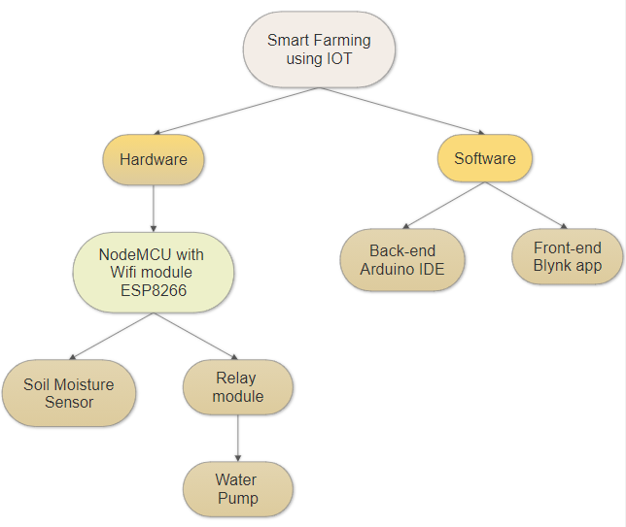
Methodology

Slide 11
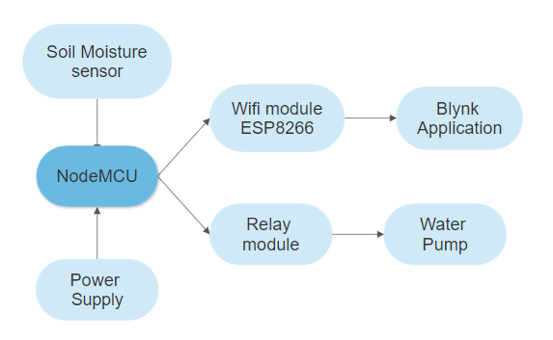
Methodology

Slide 12
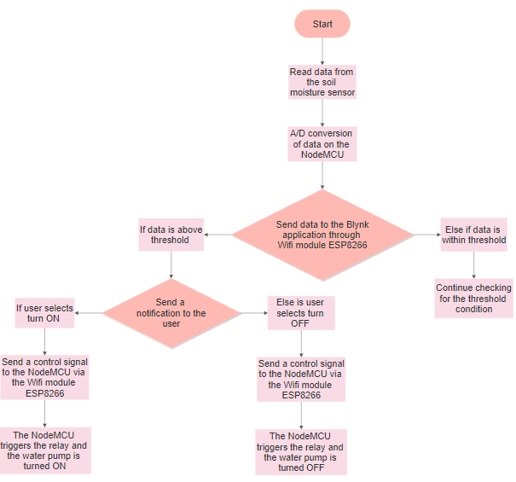
Methodology

Slide 13
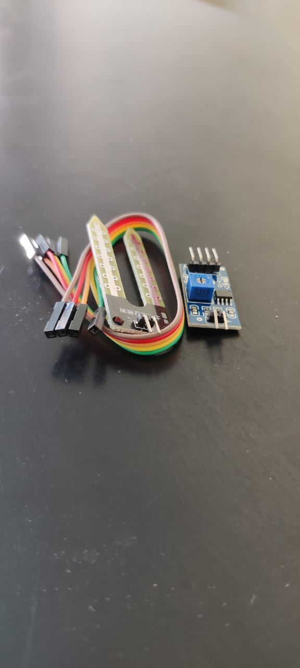
APPARATUS
SOIL MOISTURE SENSOR

Slide 14
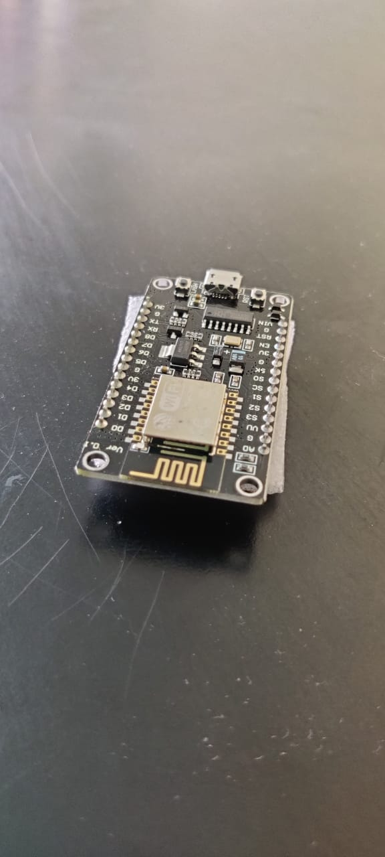
APPARATUS
NODE MCU - Microcontroller
Operating voltage – 3.3V
Input Voltage – 4.5 to 10V

Slide 15
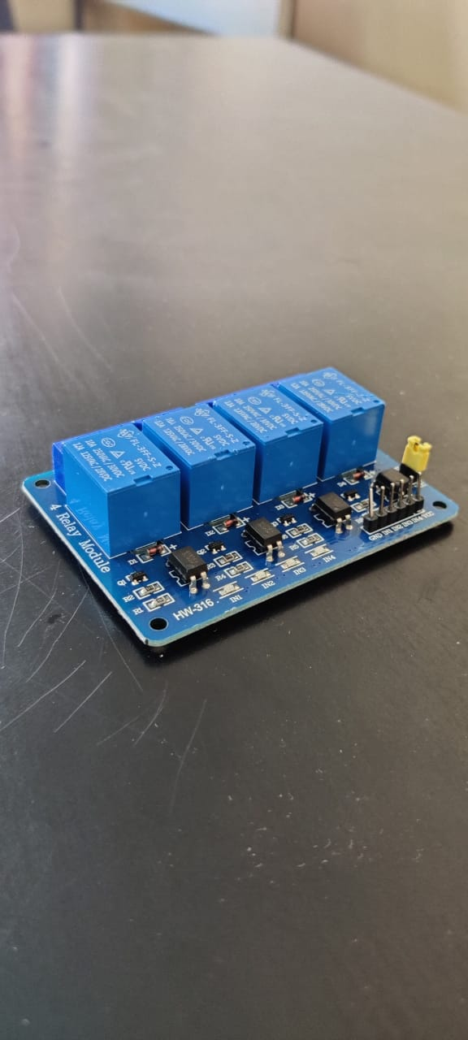
APPARATUS
RELAY MODULE

Slide 16
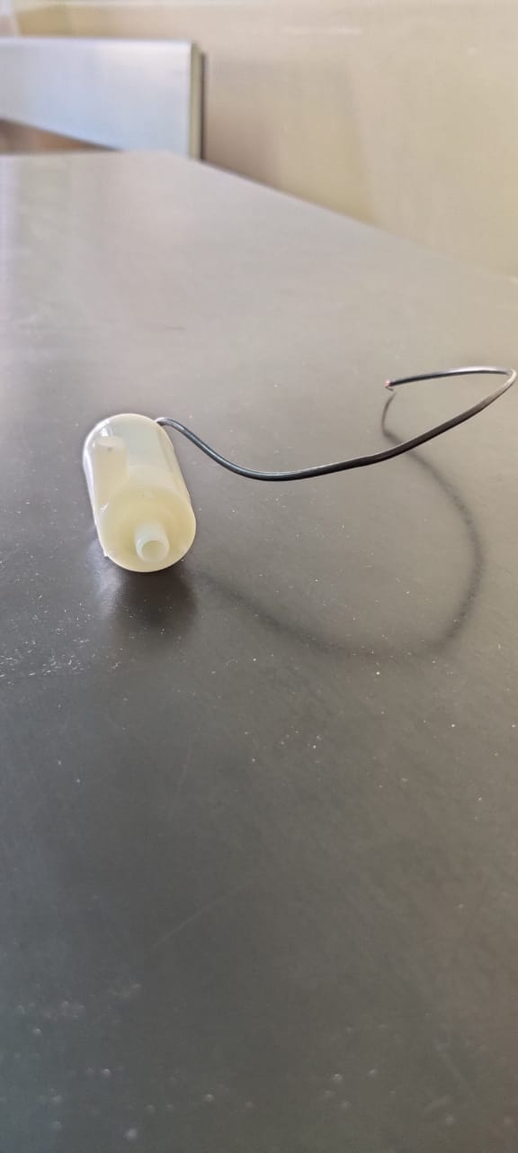
APPARATUS
WATER PUMP

Slide 17
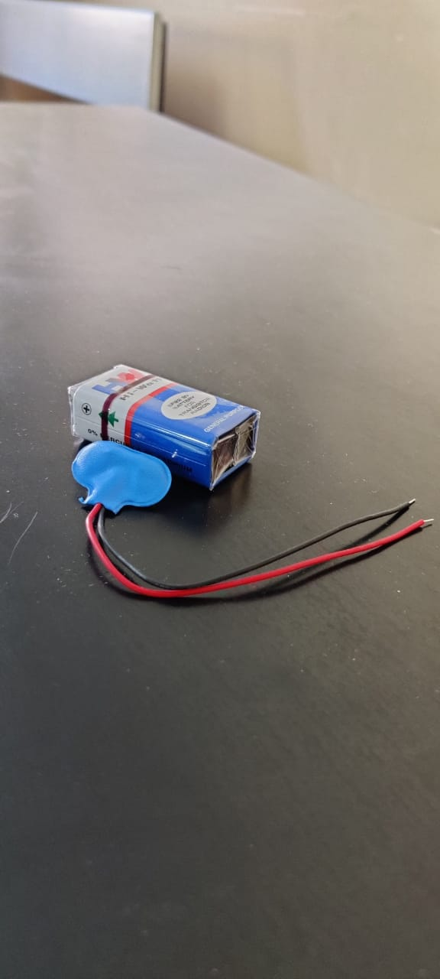
APPARATUS
9V BATTERY

Slide 18
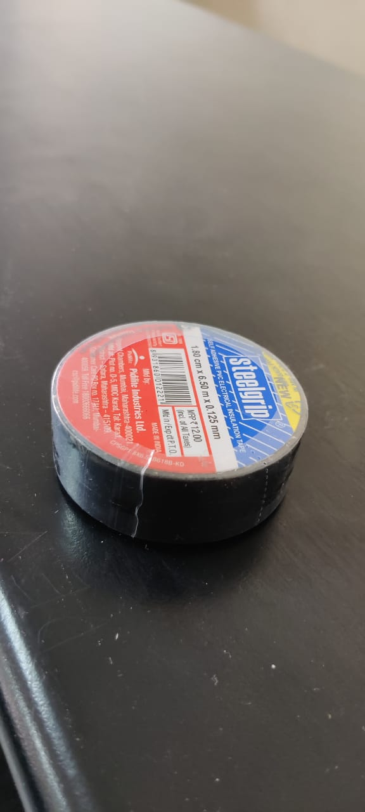
APPARATUS
INSULATION TAPE

Slide 19
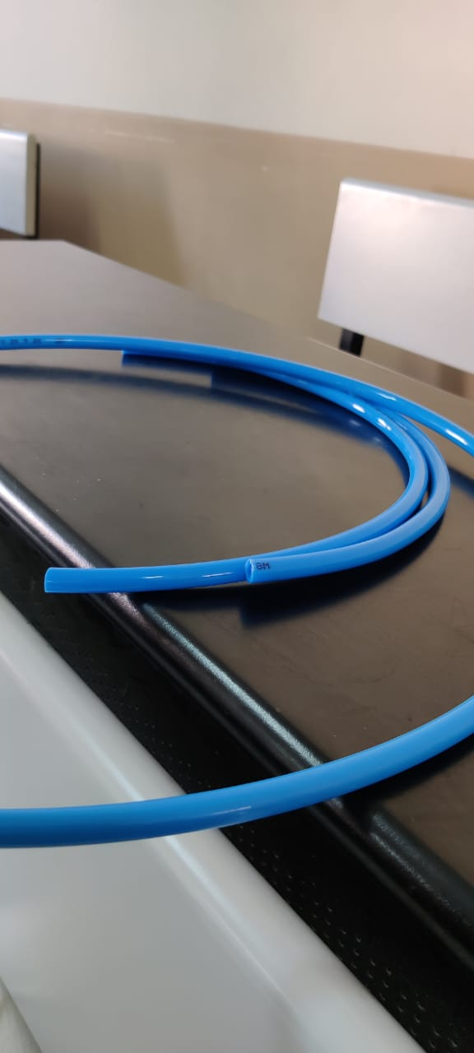
APPARATUS
HOSE PIPE 2M

Slide 20
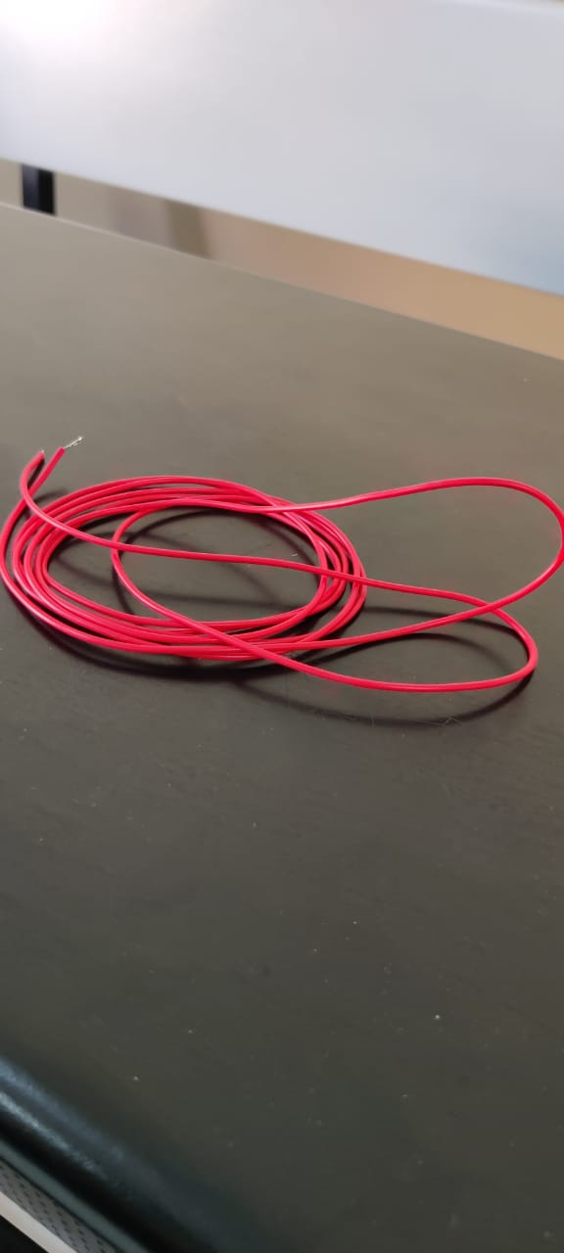
APPARATUS
CONNECTING WIRES (thin)

Slide 21
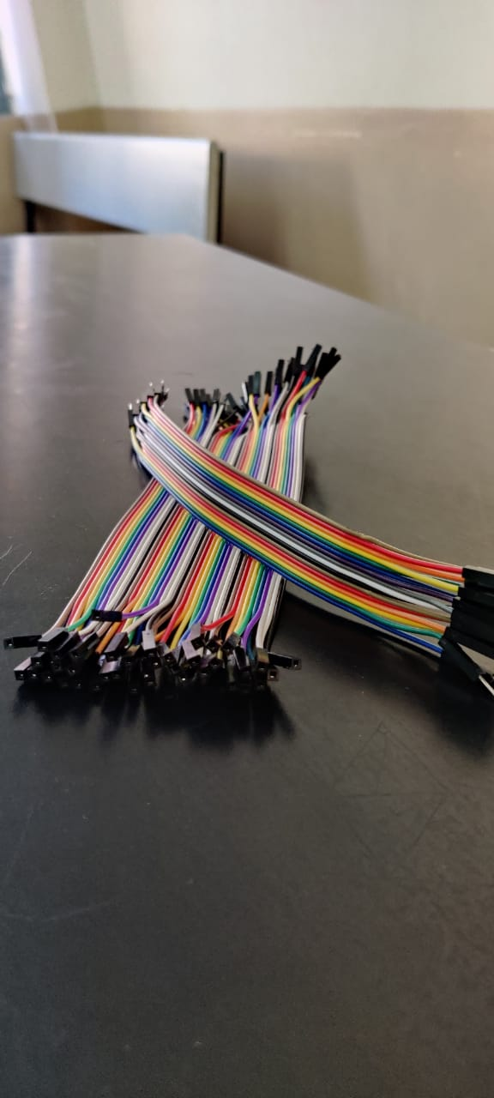
APPARATUS
FEMALE AND MALE JUMPER WIRES

Slide 22
Physics principles governing the project
Soil Moisture Sensor
Is used to detect the soil moisture content.
Has two outputs: analog output and digital output.
The digital o/p is permanent and the analog o/p threshold can be changed. The working principle of soil moisture sensor is based on open & short circuit concept. Here the LED gives an indication when the output is high or low.
When the condition of the soil is dried up, current will not flow through it. So it works like an open circuit. Therefore the o/p will be maximized
When the soil condition is soaked, the flow of current pass from one terminal to the other. So it works like a closed circuit. Therefore the o/p will be zero.
Here sensor is coated with platinum, and anti-rust to make higher efficiency as well as long life. The sensing range is also high which will pay for the farmer at a minimum cost.

Slide 23
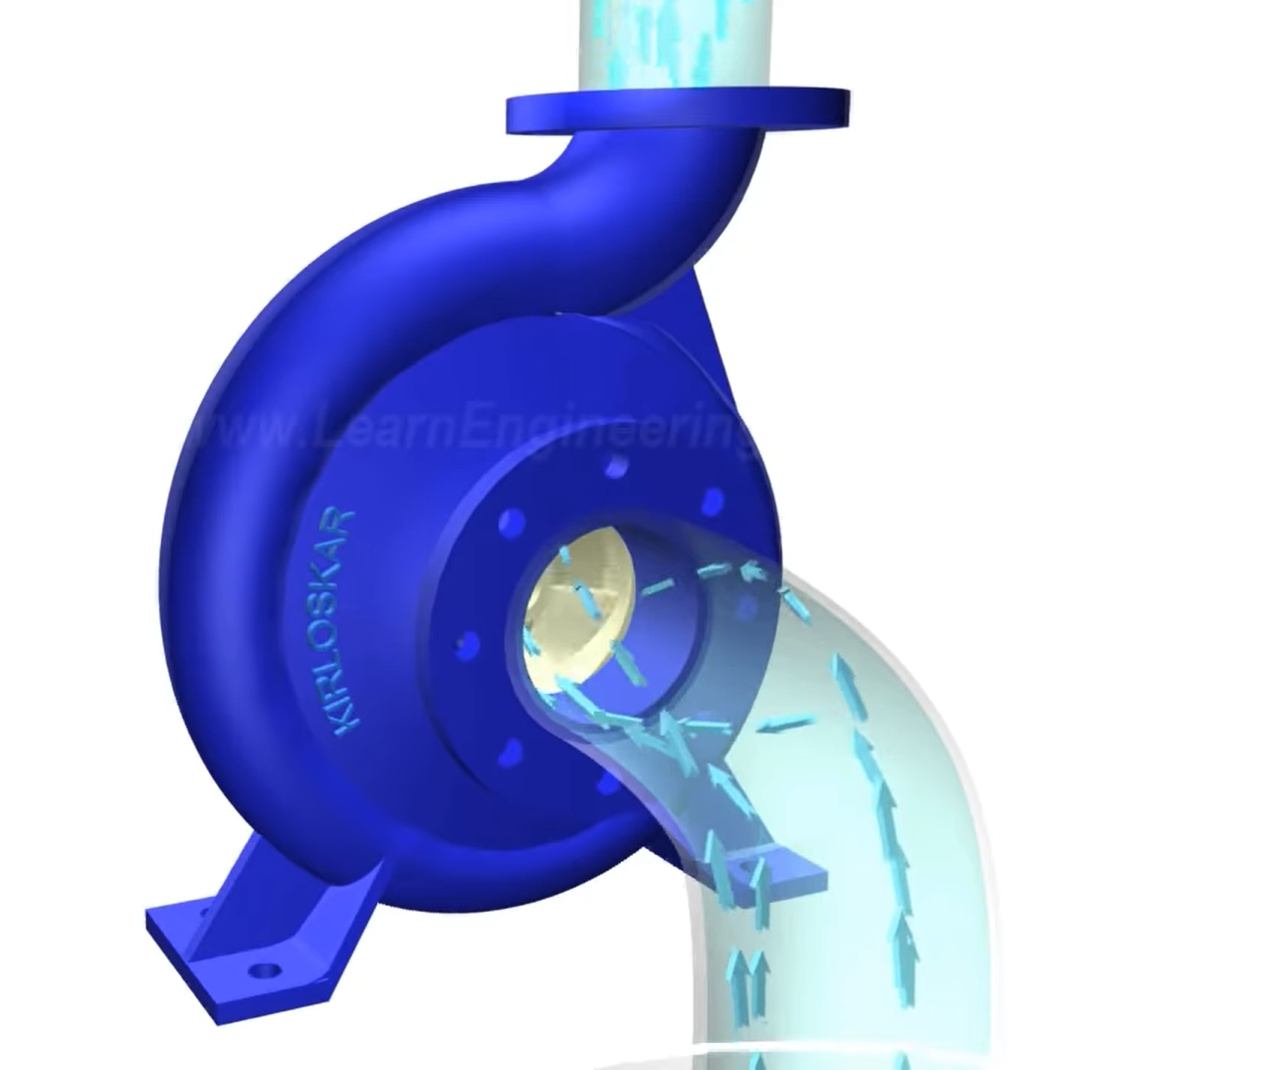
Physics principles governing the project
Water Pump Working
All centrifugal pumps include a shaft-driven impeller that rotates (usually at 1750 or 3500 RPM) inside a casing.
The impeller is always submerged in water, and when the pump is operational the impeller spins rapidly.
The centrifugal force applied to the water from this rotation forces the water outside of the casing, where it exits a discharge port.
More liquid is introduced through a suction port, or inlet. The velocity imparted to the liquid by the impeller is converted to pressure energy or "head".
Centrifugal pumps are unique because they can provide high or very high flowrates (much higher than most positive displacement pumps) and because their flowrate varies considerably with changes in the Total Dynamic Head (TDH) of the particular piping system. This allows the flowrate to be "throttled" considerably with a simple valve placed into the discharge piping, without causing excessive pressure buildup in the piping or requiring a pressure relief valve.
Therefore, centrifugal pumps can cover a very wide range of liquid pumping applications.

Slide 24
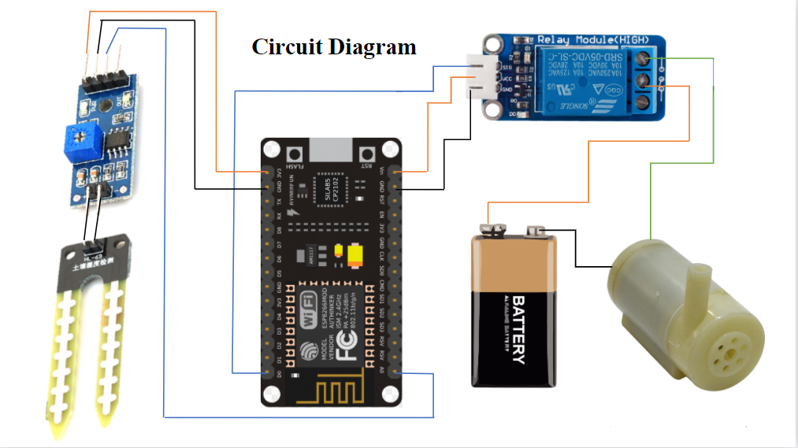
Electrical circuit

Slide 25
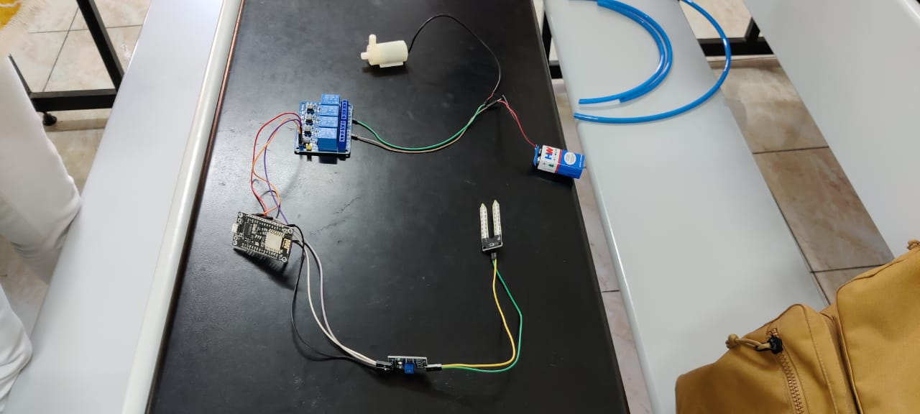
Electrical circuit

Slide 26
Civil applications of the idea
One of the important roles of Civil Engineering is the supply of water to agricultural fields. The water resources and irrigation engineering is a crucial field in civil engineering. This field of engineering is concerned with the management of quantity and quality of water in underground and above ground water resources. Water resource engineering involves the proper conservation and use of water and its associated land resources to obtain optimum development with the most economical expenditure of the funds and resources.
Through this project we aim to automate the process of irrigation in agricultural fields using concepts of IOT. The farmers can simply use their mobile phones to know the moisture content in soil and also use their smart phones to control the water pump used for irrigating the field. This not only helps conserve water but also results in better crop yield as the crops are not flooded with water when the soil already has enough moisture. The automation process also helps to decrease the manual load of farmers.

Slide 27
Practical Applications
Agriculture is a major contributor to employment and economy of the country
This field requires careful assessment of needs, and therefore it demands the adoption of technology
Practically, a number of soil moisture sensors can be used based on the area of the field
The data from all the sensors needs to be integrated and communicated to the farmer on the blank app on his/her smartphone
With a single click the farmer can now switch the irrigation pump on/off to irrigate specific parts, or whole of the field

Slide 28

Experimental Details
EXPERIMENT:
EXPERIMENTATION WITH NodeMCU AND SENSORS FOR APPLICATIONS IN SOIL MONITORING FOR ENABLING CONTROLLED WATERING OF CROPS FOR SMART IRRIGATION
In specific, this involves experimentation with Generic ESP8266 NodeMCU, 5V moisture sensors and 5V relay module with actuation using 9V pump
Testing in controlled environment

Slide 31
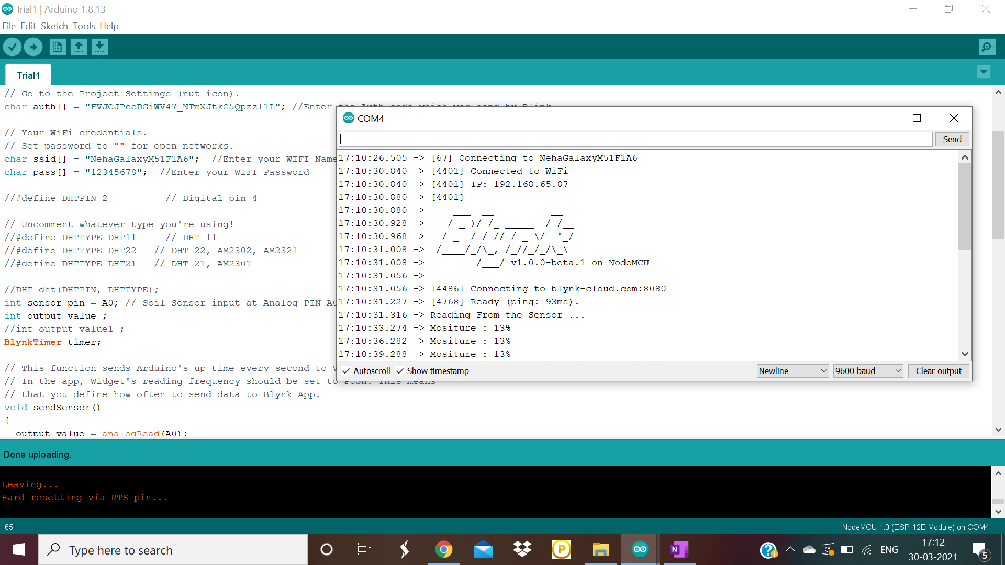
TESTING
CASE-1:
Soil is dry

Slide 32
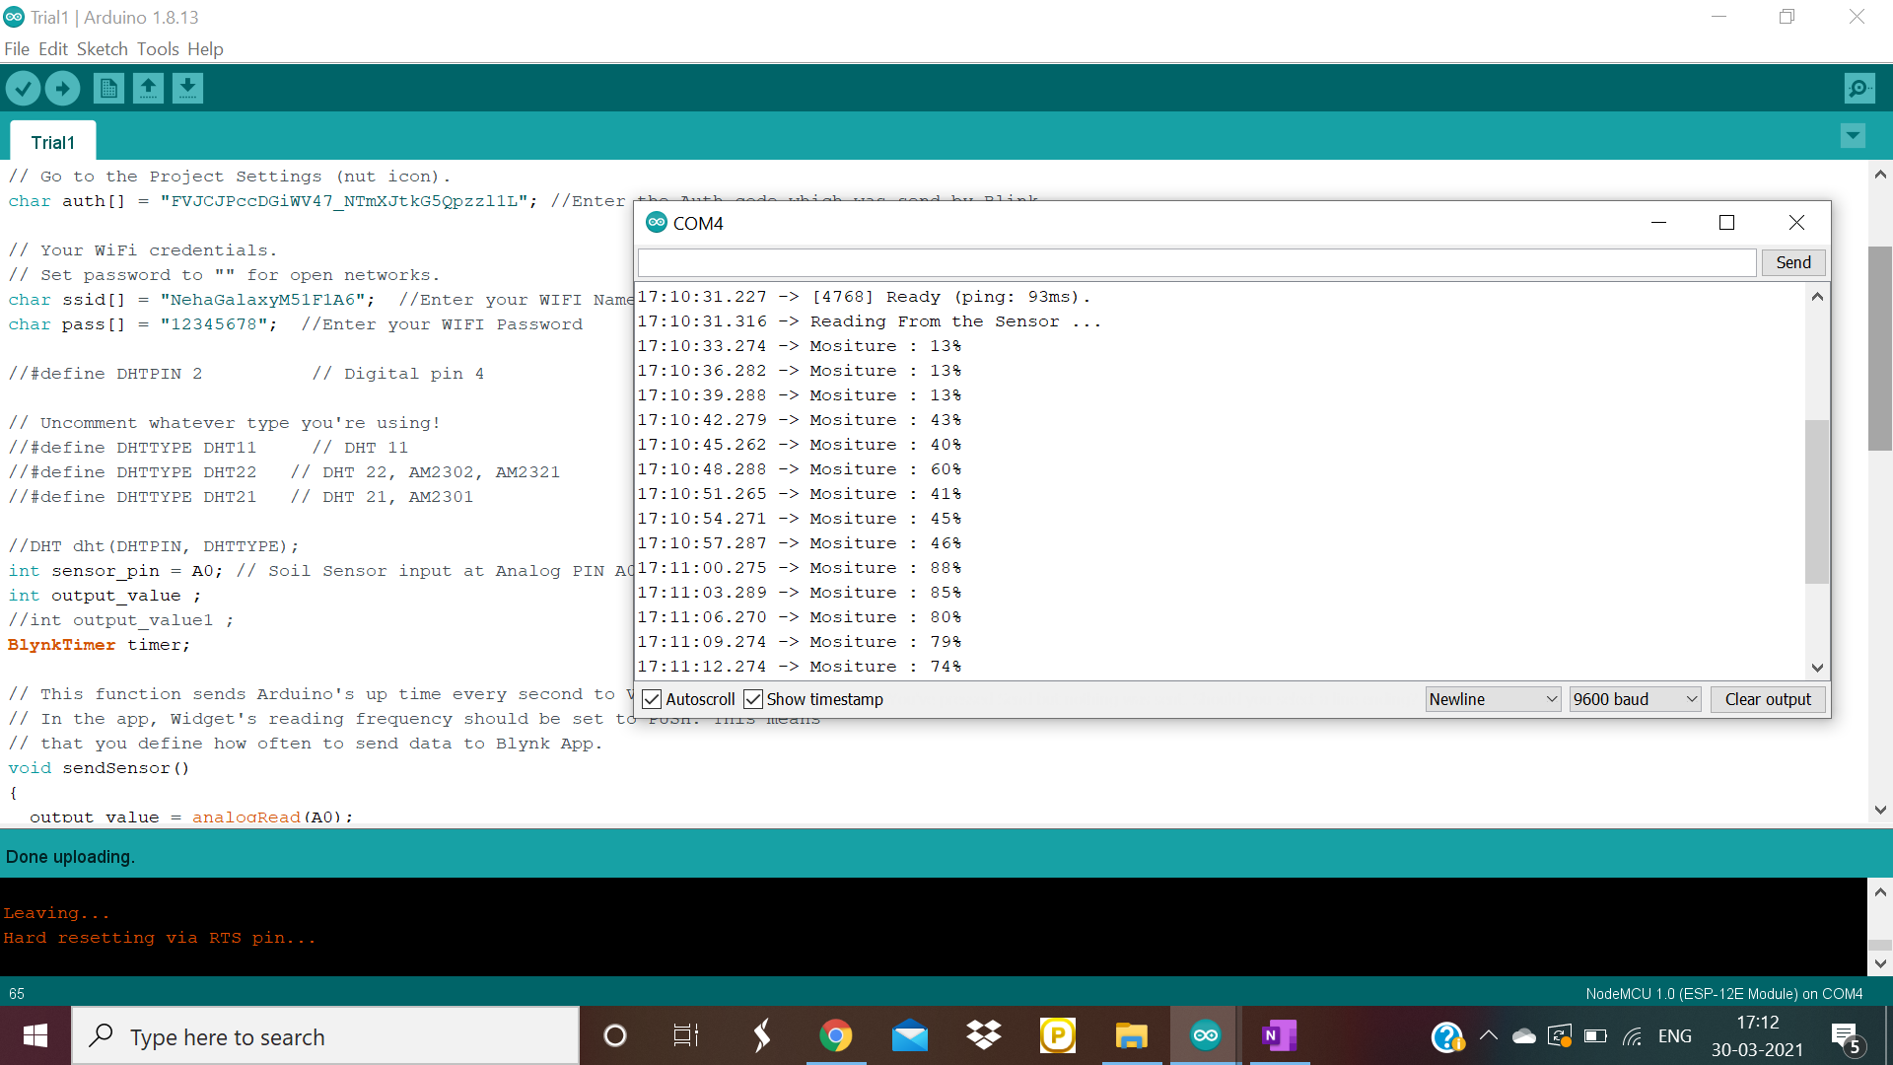
TESTING
CASE-2
Soil is wet

Slide 33
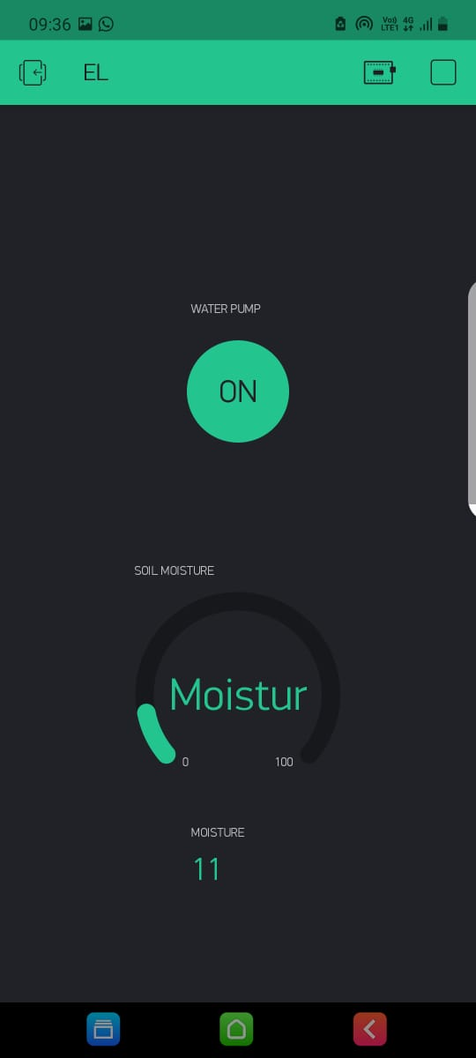
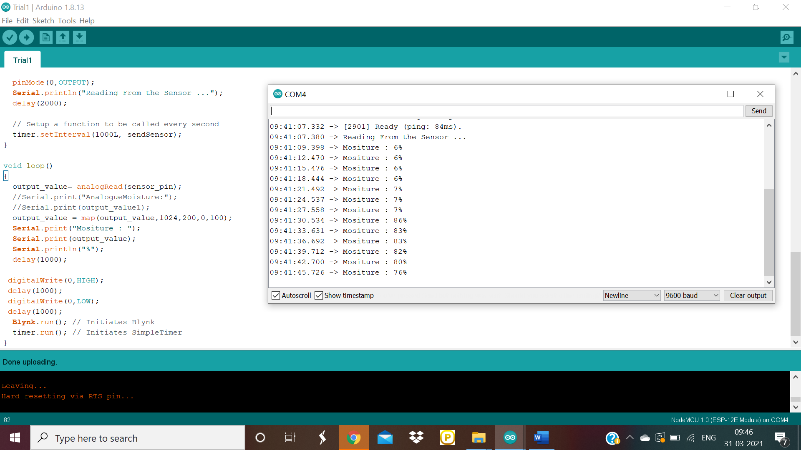
Testing

Slide 35
TESTING
The cases above apply only for the testing of the prototype
In a practical situation, the threshold above which the field needs to be irrigated will vary according to the crop and the location
A system can be built where intelligence information on water requirement of crops can be used to define the threshold
A farmer’s own experience will also help him in deciding the threshold value
Also, the number of sensors required would vary with the field area. The information obtained from a number of sensors can then be integrated and instructions can be relayed whether to irrigate a part or whole of the field

Slide 36
Results & Discussions
The sensor relay information of the soil conditions such as moisture, temperature, etc. through the wifi module to a smartphone\laptop.
This real time data can be obtained on the Blynk app.
We use this data to automate the process of irrigation using a computer program
CONDITION OF SOIL | BLYNK APPLICATION INTERFACE | INSTRUCTION | ACTION OF PUMP
DRY | Meter reads low value- 13% | ON | Sprays water
WET | Meter reads high value- 74% | OFF | Does not spray water

Slide 37
Future Scope of the Project
Fertilizers and pesticides can be mixed in water.
GPS can be used to determine the location of the farmers and then by using the climate data of that region, we can suggest other crops which can be grown on that soil.
This can also be used in households. People are busy these days and don’t have time to water plants. Thus by automating this process it can save a lot of plants and saves people’s time.
It can be used to water plants in small gardens.
Alexa/Google Home/Siri can be used to control the pump.

Slide 38
References
G. Sushanth and S. Sujatha, "IOT Based Smart Agriculture System," 2018 International Conference on Wireless Communications, Signal Processing and Networking (WiSPNET), Chennai, India, 2018, pp. 1-4, doi: 10.1109/WiSPNET.2018.8538702.
G. Shanmugasundaram, K. K. Prasanth, G. Magesh and B. Sriram, "Automated Irrigation System," 2019 IEEE International Conference on System, Computation, Automation and Networking (ICSCAN), Pondicherry, India, 2019, pp. 1-6, doi: 10.1109/ICSCAN.2019.8878737.
S. B. Saraf and D. H. Gawali, "IoT based smart irrigation monitoring and controlling system," 2017 2nd IEEE International Conference on Recent Trends in Electronics, Information & Communication Technology (RTEICT), Bangalore, India, 2017, pp. 815-819, doi: 10.1109/RTEICT.2017.8256711
Neha K. Nawandar, Vishal R. Satpute, IoT based low cost and intelligent module for smart irrigation system,Computers and Electronics in Agriculture,Volume 162,2019,Pages 979-990, https://doi.org/10.1016/j.compag.2019.05.027.(https://www.sciencedirect.com/science/article/pii/S0168169918318076)
https://www.iotforall.com/iot-applications-in-agriculture#:~:text=To%20meet%20the%20needs%20of,gain%20a%20much%2Dneeded%20edge.&text=In%20IoT%2Dbased%20smart%20farming,%2C%20soil%20moisture%2C%20etc.)
https://www.digiteum.com/iot-agriculture/
https://easternpeak.com/blog/iot-in-agriculture-technology-use-cases-for-smart-farming-and-challenges-to-consider/
https://www.electronicsforu.com/electronics-projects/hardware-diy/iot-based-smart-agriculture-system
https://create.arduino.cc/projecthub/apoorvtripathi1999/smart-farming-system-0aa139
https://www.biz4intellia.com/blog/5-applications-of-iot-in-agriculture/

